Slide 1
Cloud vs On-Premise Software

Slide 2
Since the birth of industry and commerce, humans have needed increasingly better ways to store data and access it whenever required. While valuable information was stored physically on paper in the pre-computer era, today, data is predominantly stored in hard drives of computers and servers. These hard drives and servers can store, process, and retrieve a considerable amount of data quickly and conveniently.
However, both hard drives and servers come with their limitations, and the rate at which today’s businesses and industries are growing, the need for storage that can store and process increasingly more significant amounts of data has become a priority. This is where Cloud Computing has come to the rescue!

Slide 3
Before the inception of Cloud Computing platforms, businesses predominantly relied on servers, databases, hardware, software, and other peripherals to take their businesses online.
Companies had to buy these components to ensure that their website or applications reached to the users.

Slide 4
Besides, businesses also needed a team of experts to manage the hardware and software, and to monitor the infrastructure.
While this approach was practical, it came with its unique issues, like the high cost of setup, complex components, and limited storage space, to name a few. Cloud Computing was created to address these problems.

Slide 5
The fundamental difference between cloud vs on-premise software is where it resides. On-premise software is installed locally, on your business' computers and servers, where cloud software is hosted on the vendor's server and accessed via a web browser.
As well as accessibility, there are a raft of other things that need to be considered when making a decision., including software ownership, cost of ownership, software updates and additional services, such as support and implementation.

Slide 6
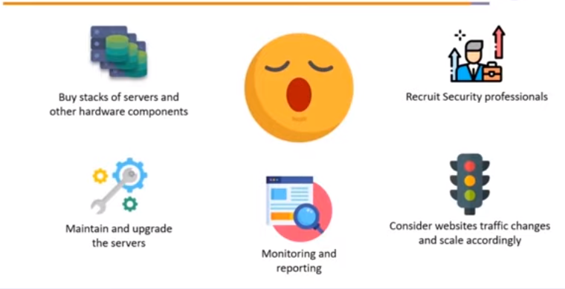
On Premise

Slide 7
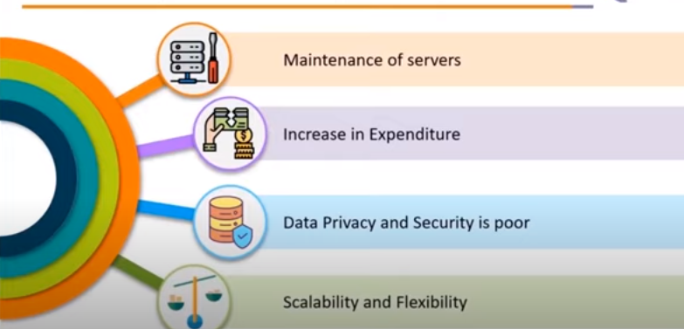
Disadvantages with On Premise

Slide 8
Drawbacks with On Premise
Large capital expenditure – On-premise systems usually require large upfront purchase which means capital expenditure (CapEx) is often required. On top you need to include maintenance costs to ensure support and functionality upgrades.
Responsibility for maintenance – With an on premise system, you are responsible for maintaining server hardware and software, data backups, storage and disaster recovery. This can be an issue for smaller companies who have limited budgets and technical resources.
Longer implementation times – On-premise implementations take longer due to the time needed to complete installations on servers and each individual computer/laptop.

Slide 9
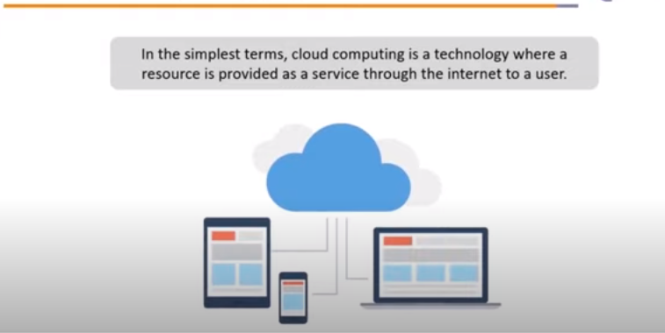
Cloud Computing

Slide 10
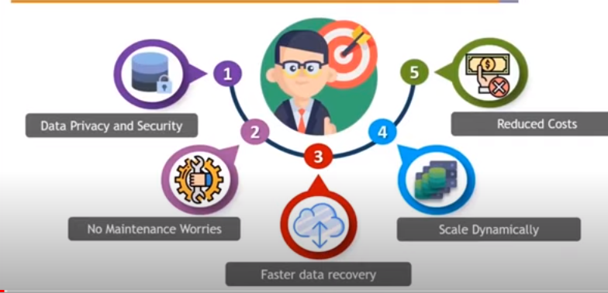

Slide 11
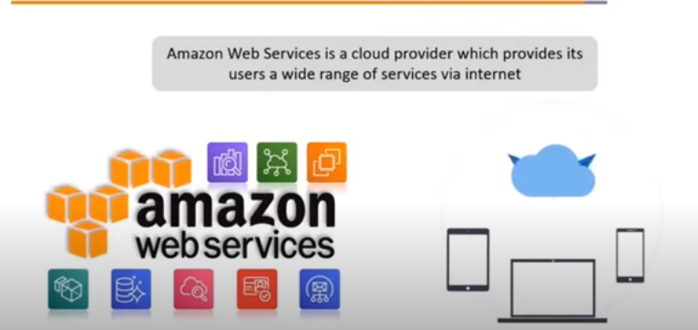

Slide 12
Amazon Web Services (AWS) was launched by the ecommerce giant Amazon in 2006, quickly growing into a company that has fundamentally transformed the IT industry in an era of widespread cloud computing and carved out a market-leading position.

Slide 13
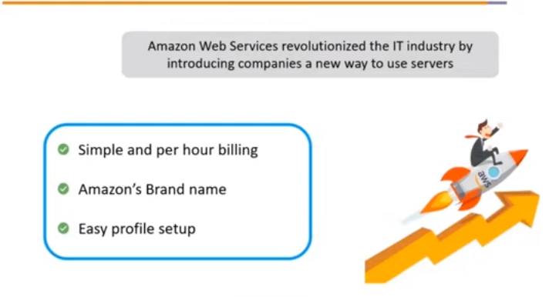

Slide 14
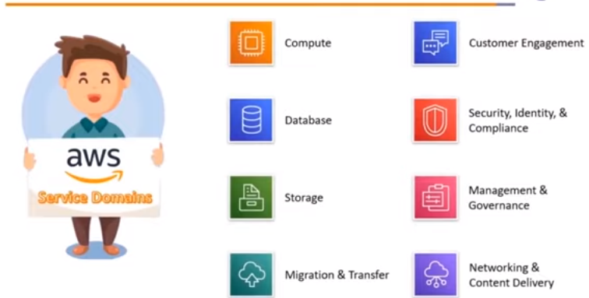

Slide 15
Advantages
Anywhere and anytime access – You can access your applications anytime and anywhere via a web browser from any device.
Affordable – Cloud requires no upfront costs, instead you make regular payments which makes it an operating expense (OpEx). While the monthly cost adds up over time, maintenance and support services are included removing the need for annual contracts.
Predictable costs – Benefit from predictable monthly payments that cover software licences, upgrades, support and daily back-ups.
Worry free IT – Because cloud software is hosted for you, you don’t need to worry about the maintenance of your software or the hardware it resides on, compatibility and upgrades are taken care of by the cloud service provider.

Slide 16
High levels of security – Data centres employ security measures beyond the affordability of most businesses, therefore your data is often safer in the cloud than on a server in your offices.
Quick deployment– Cloud-based software is deployed over the Internet in a matter of hours/days because, compared to on premise applications which needs to be installed on a the physical server and each PC or laptop.
Scalability – Cloud technologies provide greater flexibility as you only pay for what you use and can easily scale to meet demand, for example adding and scaling back licences.
Lower energy costs - When you move to the cloud, you no longer have to pay to power on-premise servers or to maintain their environment. This significantly reduces the amount you pay on your energy bills.

Slide 17
AWS jobs that you can go for along with an AWS certification.
1. Cloud Developer
2. AWS Cloud Architect
3. AWS SysOps Administrator
4. Cloud Software Engineer

